Slide 1
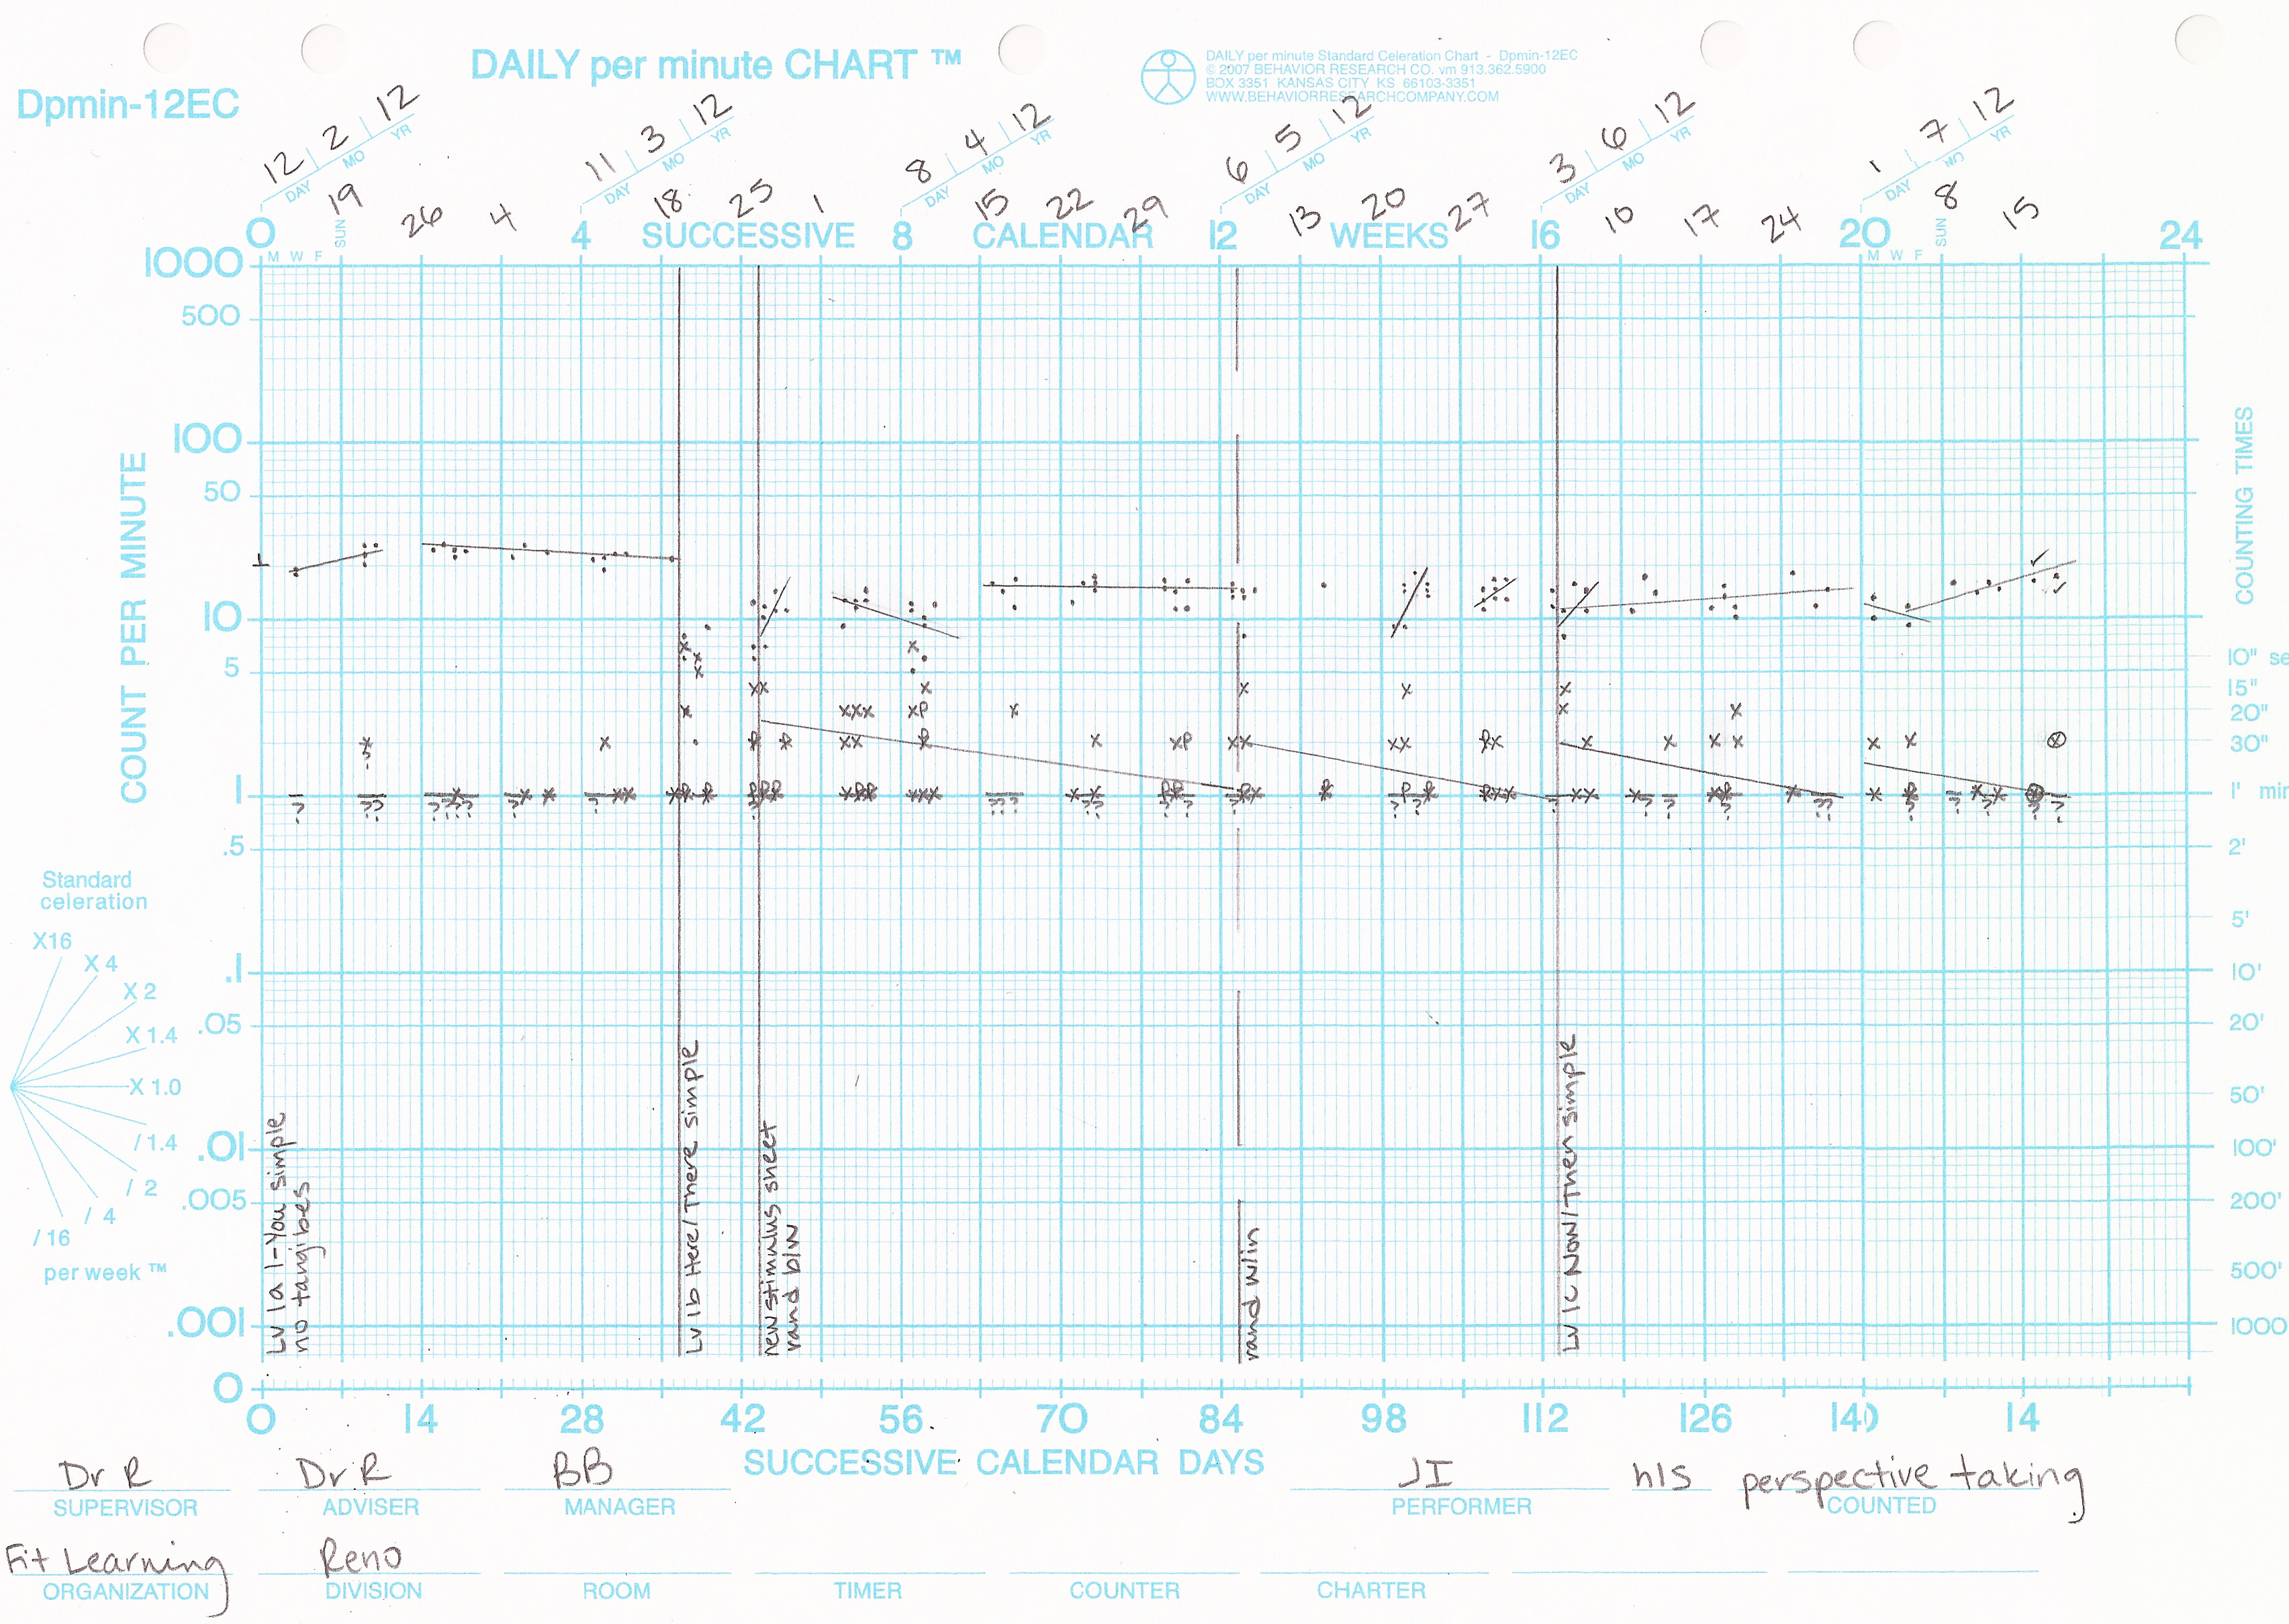
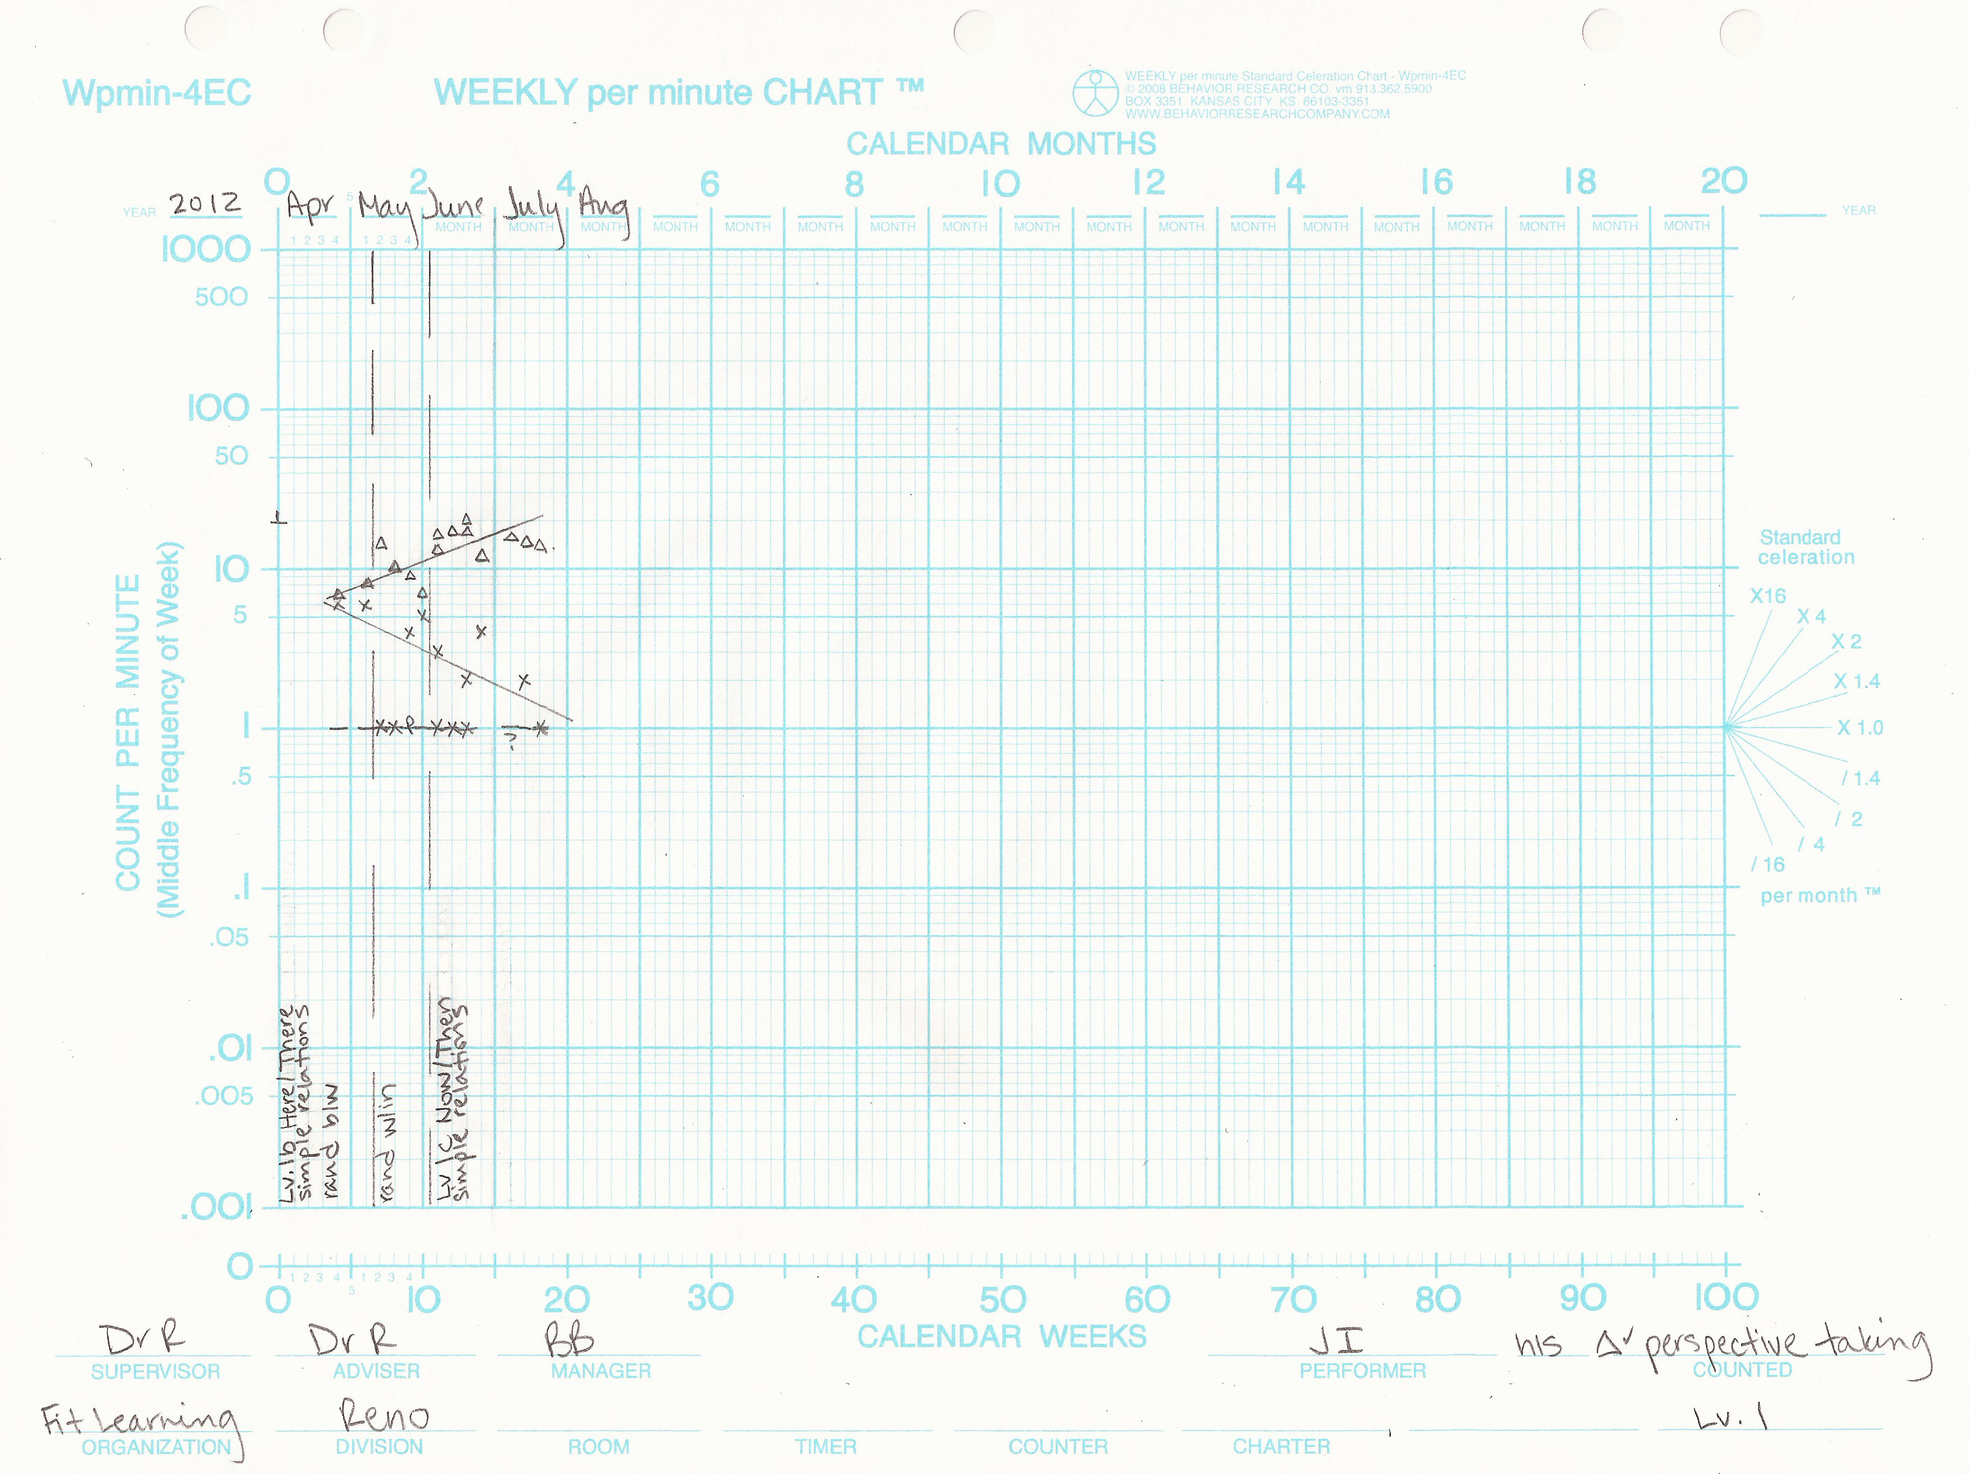
Utilizing Fluency-Building to Train Deictic Relational Responding in a Young Child with Autism Brooke M. Berry and Kendra Brooks Rickard Fit Learning, Reno, NV
Introduction
Perspective-Taking and Autism
Impairment in the ability to develop social relationships is a hallmark characteristic of autism spectrum disorder (ASD) (Baron-Cohen, 1988).
Children with ASD show deficits in perspective-taking abilities compared to typically developing children, which could account for social impairment (Rehfeldt et al., 2007).
Behavioral researchers have attempted to impact perspective-taking by training the deictic relations I-You, Here-There, and Now-Then (Rehfeldt et al., 2007; Weil et al., 2011; Gould et al., 2011; Candido & Jackson, 2012). However, training in children with autism has been limited and has consisted solely of discrete trial training.
Purpose of Present Study
The present case study replicated and extended Weil et al. (2011) to assess whether a perspective-taking repertoire could be established in a young child with autism utilizing a fluency-building paradigm.
Results
Training
Probes
A multiple probe element was included to evaluate the potential generative impact on untrained relations as a function of training on initial deictic relations.
Traditional Theory of Mind (ToM) skills were assessed at baseline and after fluency was achieved on all relations.
Training Stimuli and Probes
Stimuli were adapted from McHugh et al. (2004). Both words and scenarios were simplified to better match the cognitive level of the participant.
Probes were conducted approximately once per week in the absence of reinforcement and consisted of a mixture of all three deictic relations at the simple level.
Theory of Mind
 | Level 1 | Level 2 | Level 3A | Level 3B | Level 4 | Level 5A | Level 5B
 | Simple Visual Perspective Taking | Complex Visual Perspective Taking | Seeing Leads to Knowing - Self | Seeing Leads to Knowing - Other | Predicting Actions on the Basis of a Person’s Knowledge | Understanding False Beliefs – Unexpected Transfer Task | Understanding False Beliefs – Unexpected Contents Task
Pre | 100% | 89% | 0% | 50% | 63% | 25% | 50%
Post | 100% | 100% | 0% | 100% | 67% | 50% | 67%
Training Levels and Relations
Discussion
Like Weil et al. (2001), improvement was observed across relations, including those that had not yet been trained. This suggests the acquisition of a generalized relational operant.
Performance on ToM tasks showed overall improvement after training on relations at the simple level. This differs from Weil et al. (2011), in which ToM tasks did not begin to improve until training at the reversed and double reversed levels.
Although this was a case study, results suggest that utilizing fluency-building to train perspective-taking could carry potential benefits beyond those seen through discrete trials only.
Limitations include a case study design and training relations only at the simple level.
Directions for future research: training relations at all three levels of complexity (simple, reversed, and double reversed) as well as including more participants in an experimental design that compares fluency-building to discrete trial training.
I-You | Simple | Reversed | Double-Reversed
Here-There | Simple | Reversed | Double-Reversed
Now-Then | Simple | Reversed | Double-Reversed
Method
Design
Case study, in which the participant was a 6 year-old boy with high functioning autism.
The deictic relations I-You, Here-There, and Now-Then were trained to fluency at the simple level, in which relations are not reversed.
Rate of response was shaped to reach a specified frequency goal based on normative sampling. Response stability and low errors over a number of sessions were required before responding was considered fluent and training began on the next relation.
Theory of Mind Tasks
ToM tasks were adapted from Howlin et al. (1999) and consisted of Part II, Levels 1-5. These were: Simple and Complex Visual Perspective-Taking (Levels 1 & 2), Seeing Leads to Knowing (Level 3A: Self, Level 3B: Other), Predicting Actions on the Basis of a Person’s Knowledge (Level 4), and Understanding False Beliefs (Level 5A: Unexpected Transfer Task, Level 5B: Unexpected Contents Task).

